Slide 1
Fuzzy-GA-Based Trajectory Planner For Robot Manipulators Sharing a Common Workspace
IEEE TRANSACTIONS ON ROBOTICS, VOL. 22, NO. 4, AUGUST 2006

Slide 2
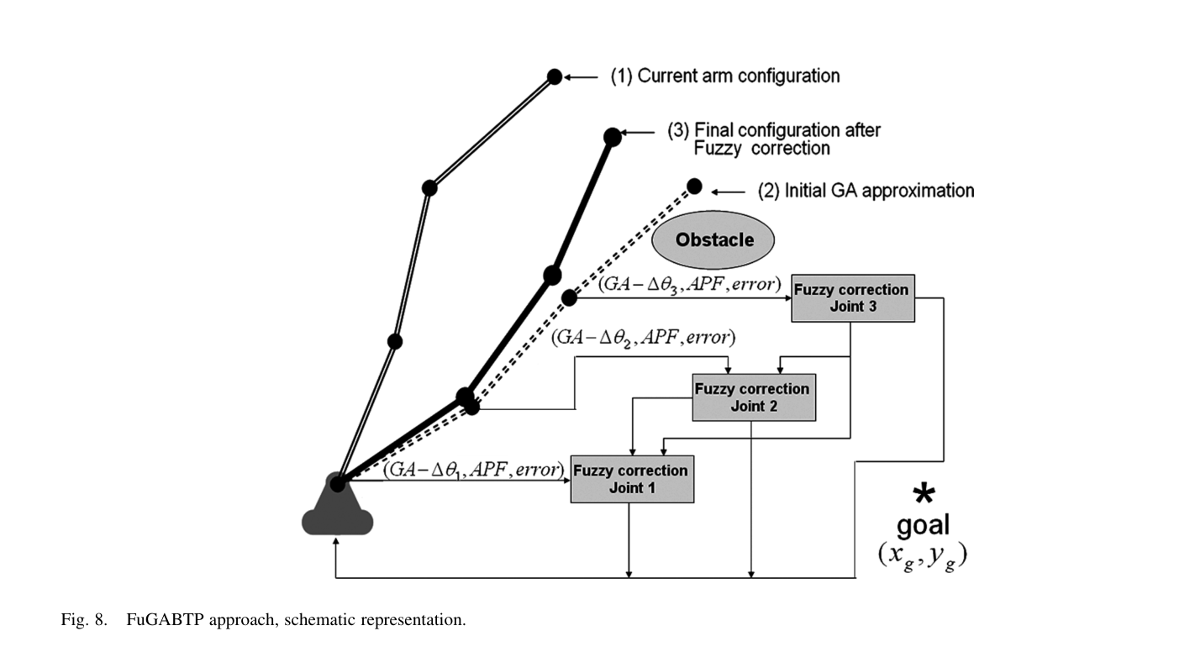
Method

Slide 3
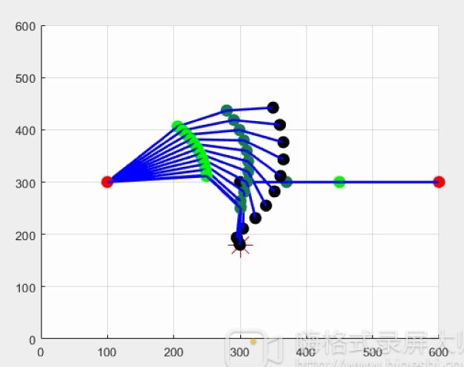
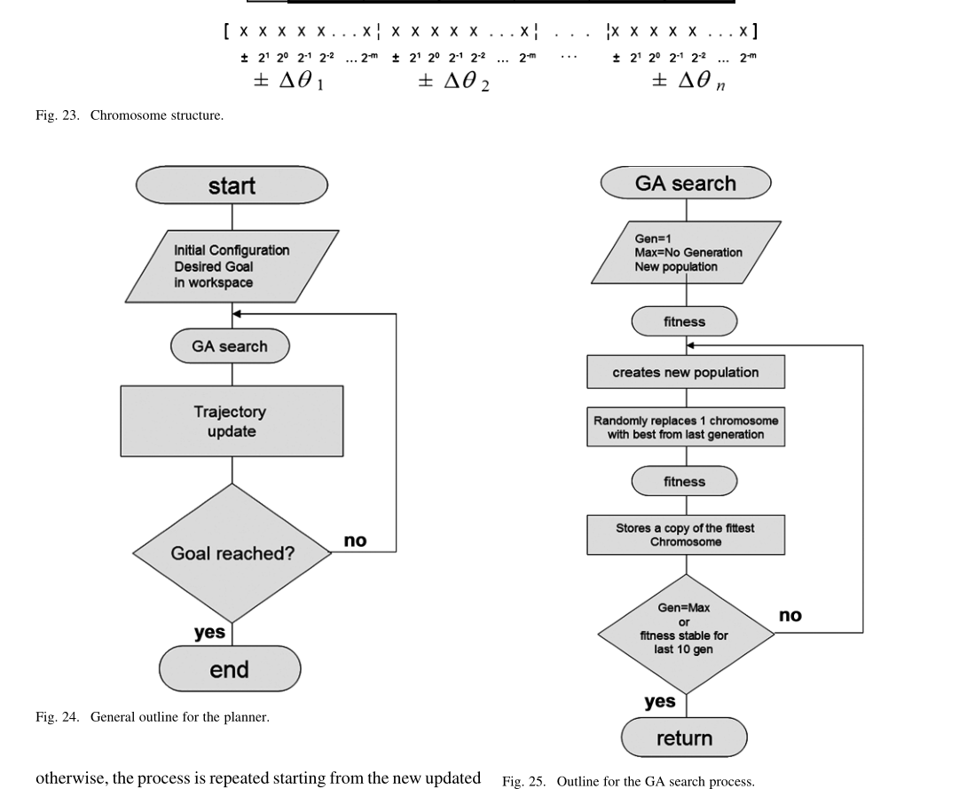
Test GA-Algorithm

Slide 4
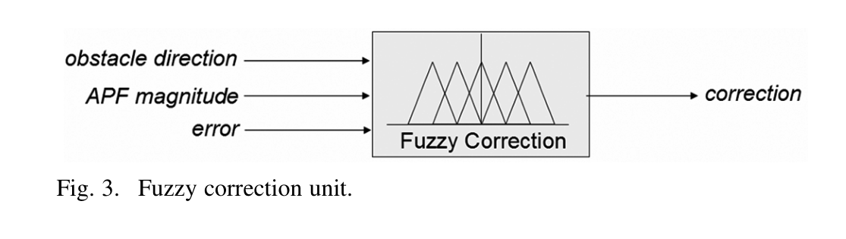
Test fuzzy-Algorithm

Slide 5
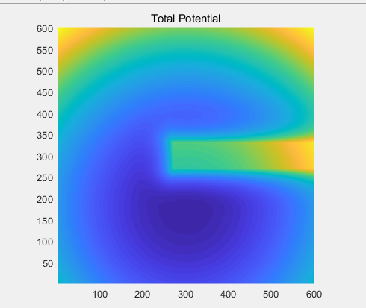
Test fuzzy-Algorithm

Slide 6
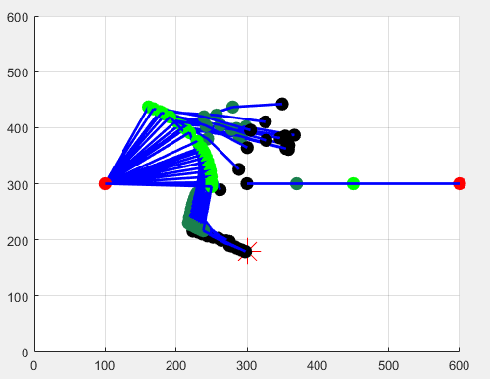
Test fuzzy-Algorithm

Slide 7
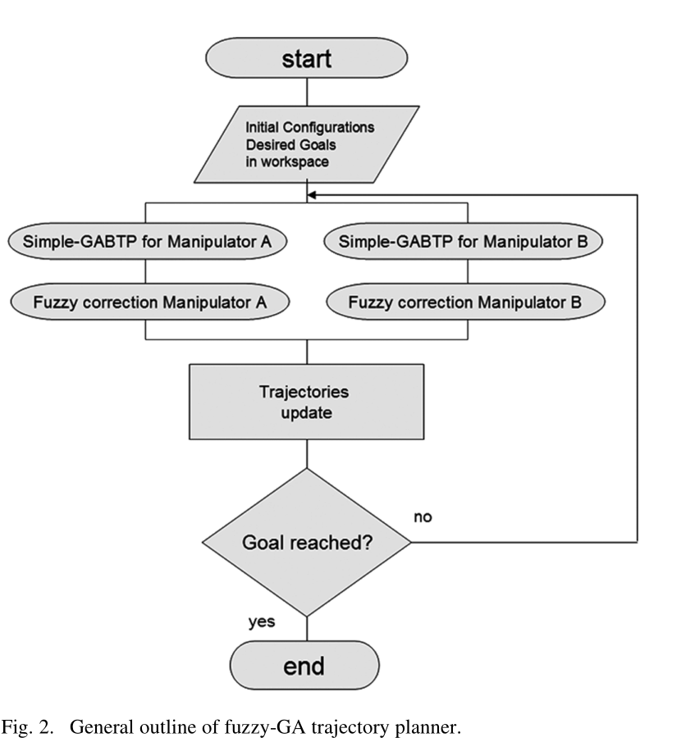
Method

Slide 8
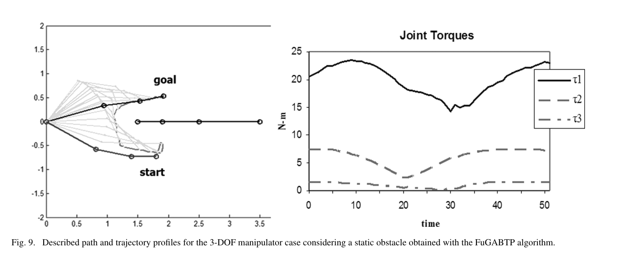
Simulation

Slide 9
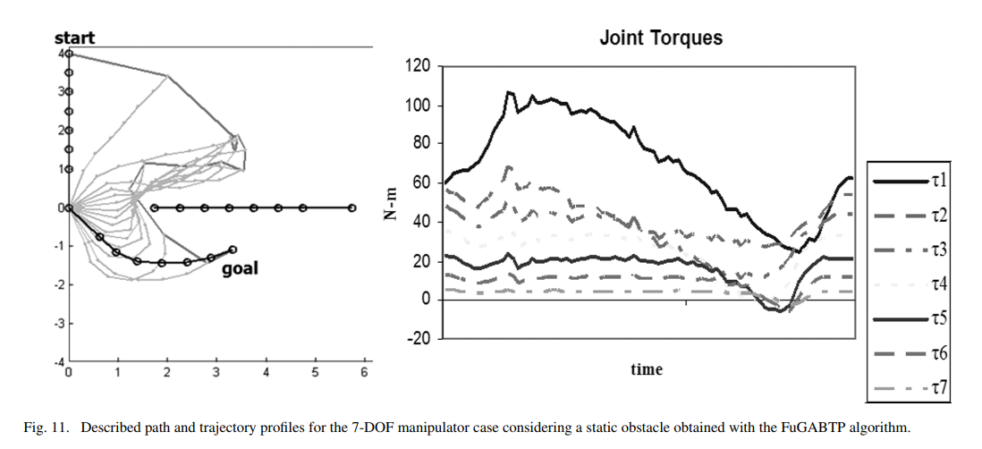
Simulation

Slide 10
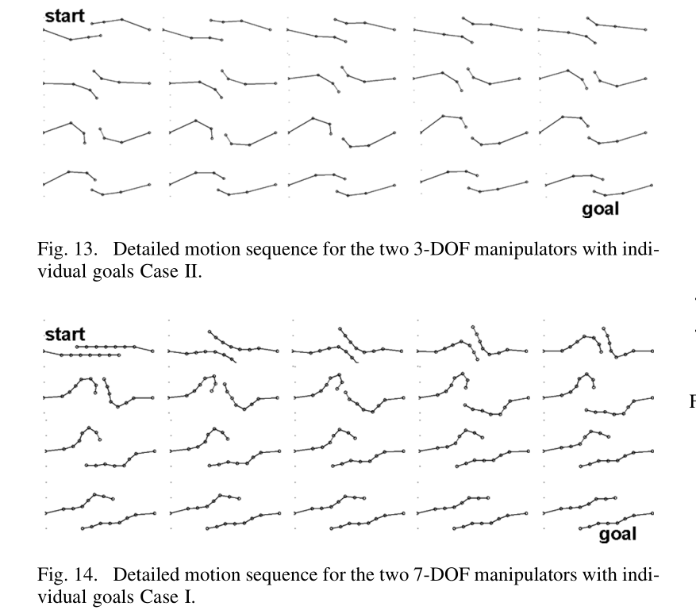
Simulation

